Slide 1
QR BASED ATTENDANCE SYSTEM
TEAM MEMBERS |  | HT.NO
P.SAI THARUN |  | (19S41A0572)
MOHAMMAD RIYAZ |  | (19S41A0554)
M.KUSHAL KUMAR |  | (19S41A0562)
SD.NAMMAN QADRI |  | (19S45A0587)
Under The Guidance of
Mrs. SABBANI ANITHA
Assistant professor

Slide 2
CONTENTS
Introduction
Proposed System
Advantages
Existing System
Disadvantages
Hardware Requirements
Software Requirements
Modules
System Designs
UML Diagram
Output Screenshots
Conclusion

Slide 3
INTRODUCTION
In this era of technology smartphones play a significant role in our day to day life. Nowadays smartphones can solve most of the problem very quickly and easily. It has made life of every person simple and easier with different social app, commercial app, problem solving app, app for education and marketing etc.
Followed by the technology the paper purposed a system that will handle a problem for recording the attendance.
The proposed system is a couple of two applications, one for generating the QR Code by entering the student details and second application for taking the attendance and generating the attendance in CSV or XLS format.

Slide 4
Proposed system
The proposed QR code-based attendance system aims to automate and streamline the attendance tracking process in various institutions, organizations, or events. This system utilizes QR (Quick Response) codes, which are two-dimensional barcodes that can be easily scanned using a smartphone or a dedicated QR code scanner.
Here's how the proposed system works:
Generation of Unique QR Codes
Displaying QR Codes
Attendance Recording
Verification and Database Integration
Real-time Reporting

Slide 5
Advantages:
This system decreases the human effort of manually taking attendance of every student & employee
There is very least possibility for proxies to occur.
In this “NO-CONTACT” period, this system can be used as an alternative to the biometric attendance system.

Slide 6
Existing system
QR code-based attendance systems are already in use in various settings, including educational institutions, corporate organizations, and event management companies. These systems offer several advantages over traditional attendance tracking methods, such as paper-based sign-in sheets or manual data entry systems.
Existing QR code-based attendance systems often incorporate additional features and functionalities, such as
Mobile Applications
Integration with Student Information Systems (SIS)
Analytics and Insights:
Security and Authentication

Slide 7
Disadvantages
The accuracy of the data collected is the biggest issue in old system.
Proxy or other ways are easily possible.
Identity can’t be manipulated

Slide 8
System Requirements
Software Requirements:
Operating system : Windows 7/10
Language : python 3.4.7,Pycharm
Domain : Machine Learning
Alogrithms : Cascade , CNN
Hardware Requirements:
Processor : intel® core(TM) i5
CPU : 1.60 GHz 1.80GHz
Ram : 4GB
Hard disk : 10GB

Slide 9
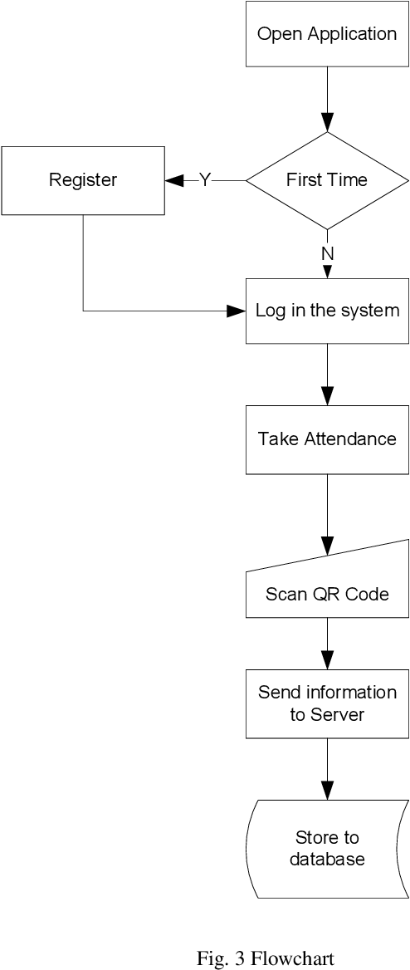
SYSTEM DESIGN
System Architecture

Slide 10
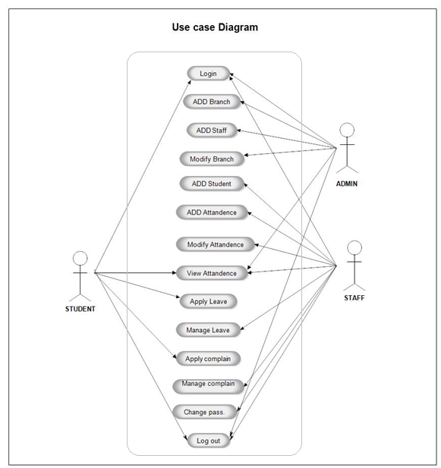
UML DIAGRAMS
Use case diagram

Slide 11
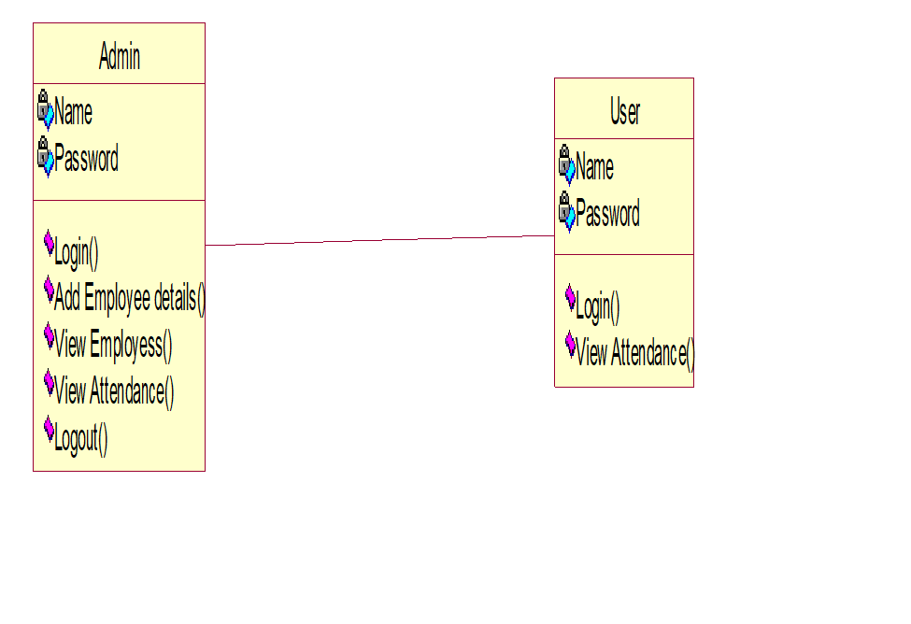
Class diagram

Slide 12
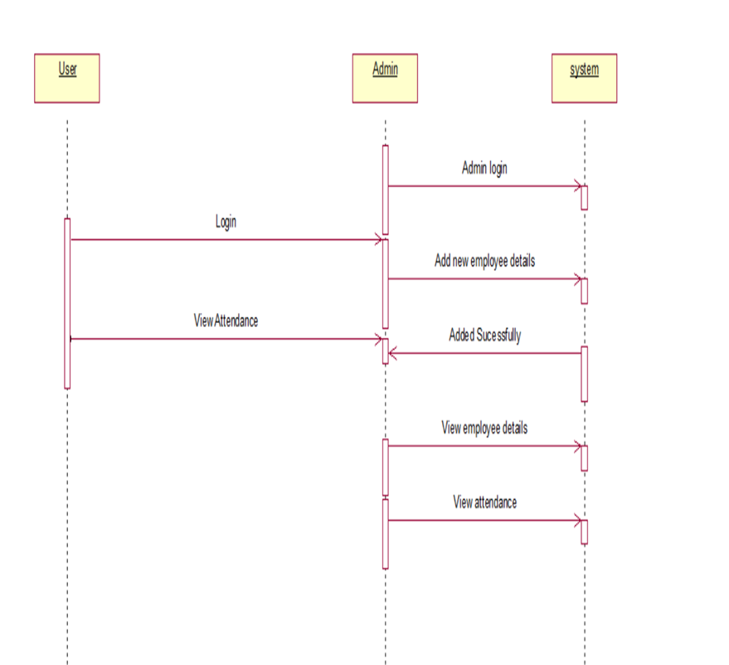
SEQUENCE DIAGRAM

Slide 13
MODULES
ADMIN MODULE
EMPLOYEE LOGIN MODULE
QR CODE WEBCAM SCANNER

Slide 14
WORKING
First we create a project in the PyCharm IDLE.
Store a few images of students in the database.
Type and execute the correct source code.
Error-free code runs and the camera opens on the laptop.
Now it detects the faces of students who stand in front of the camera according to the images stored in the database earlier.
The attendance also gets saved in a CSV file.

Slide 15
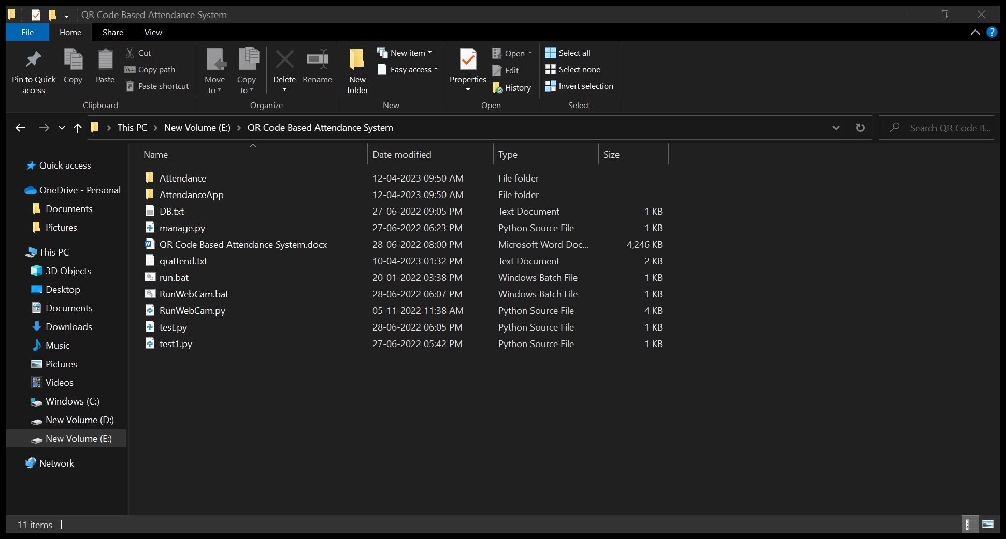
OUTPUT SCREENSHOTS
Open file Location

Slide 16
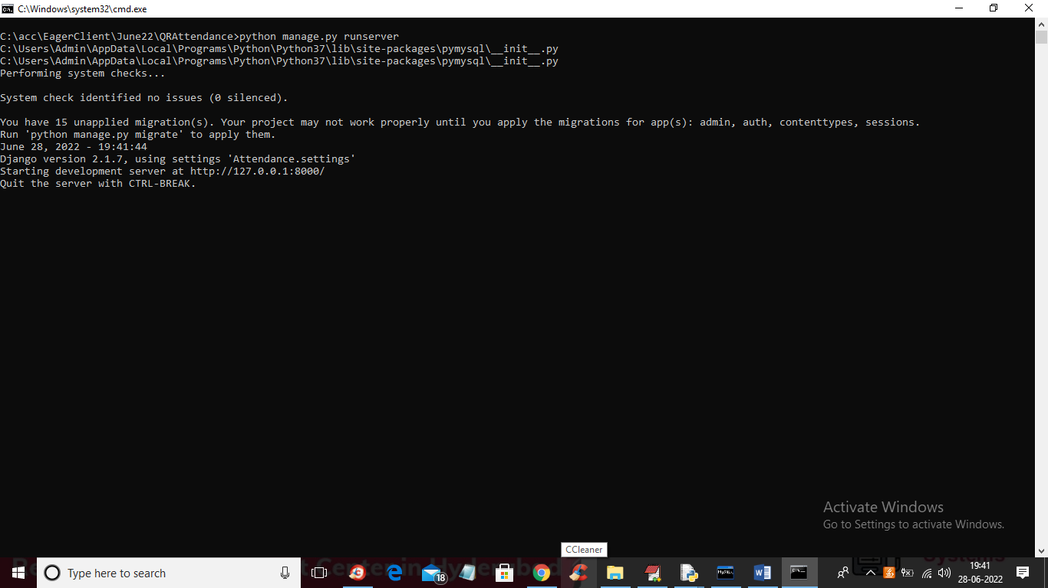
Open Cmd to move homepage

Slide 17
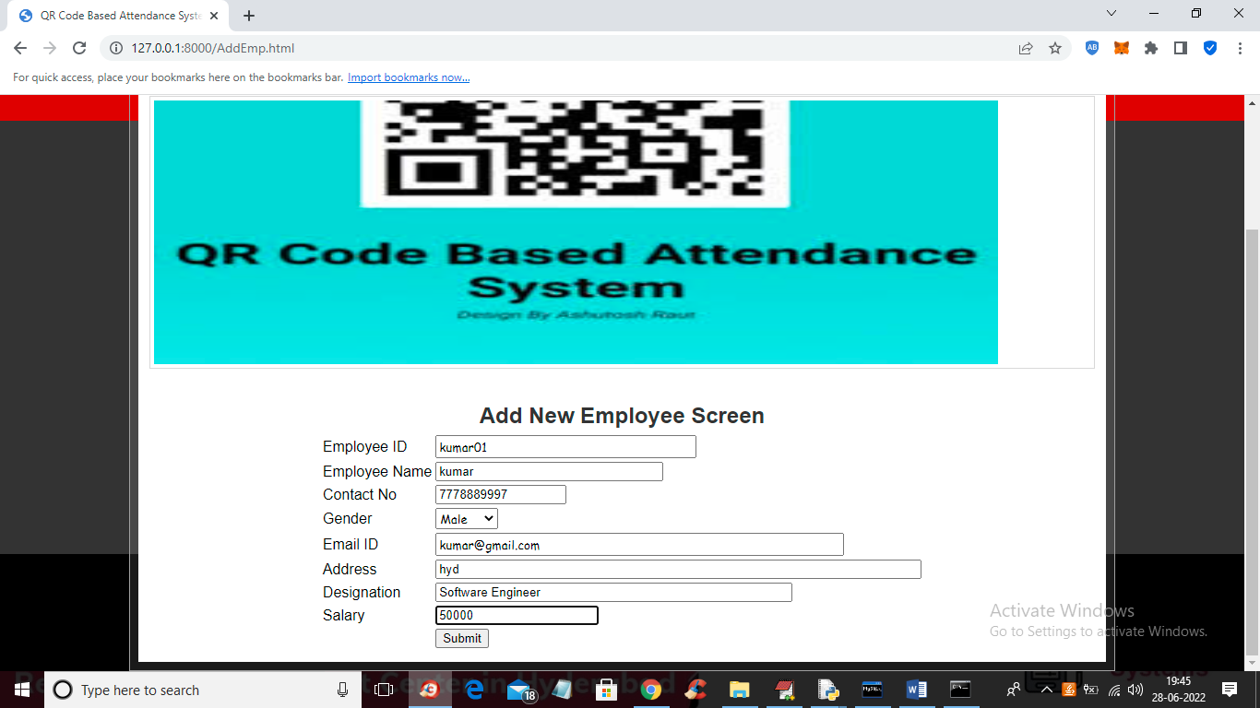
Enter Details and Train the data

Slide 18
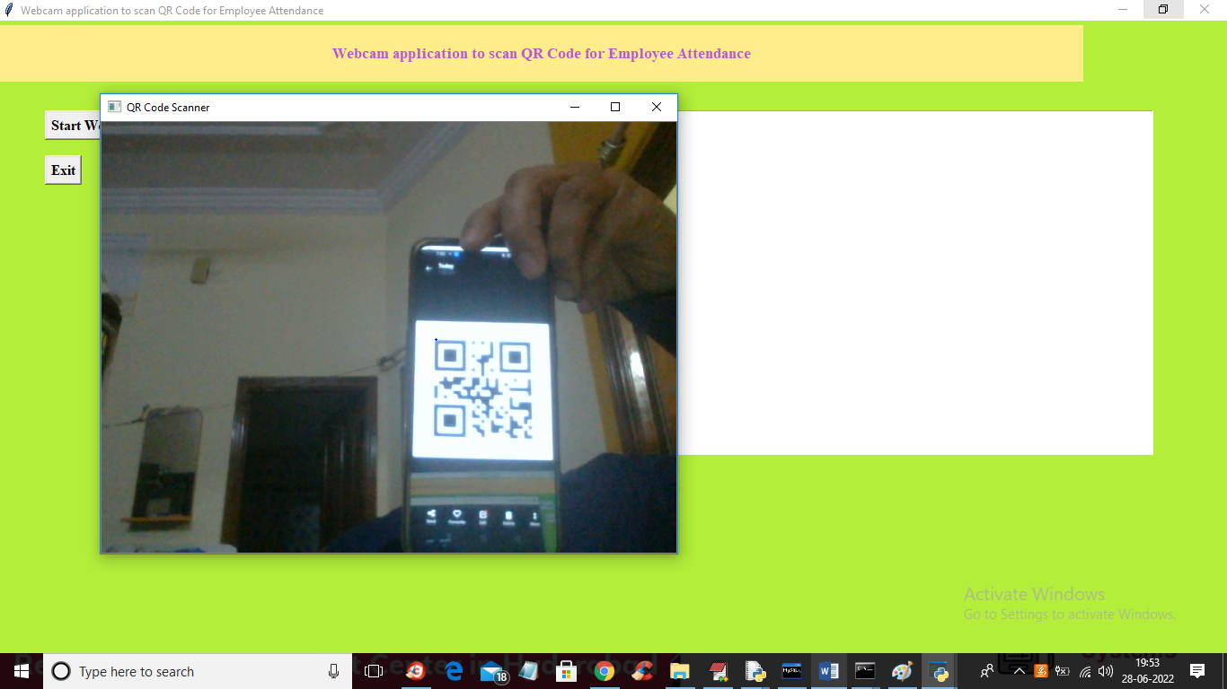
Attendance Marking

Slide 19
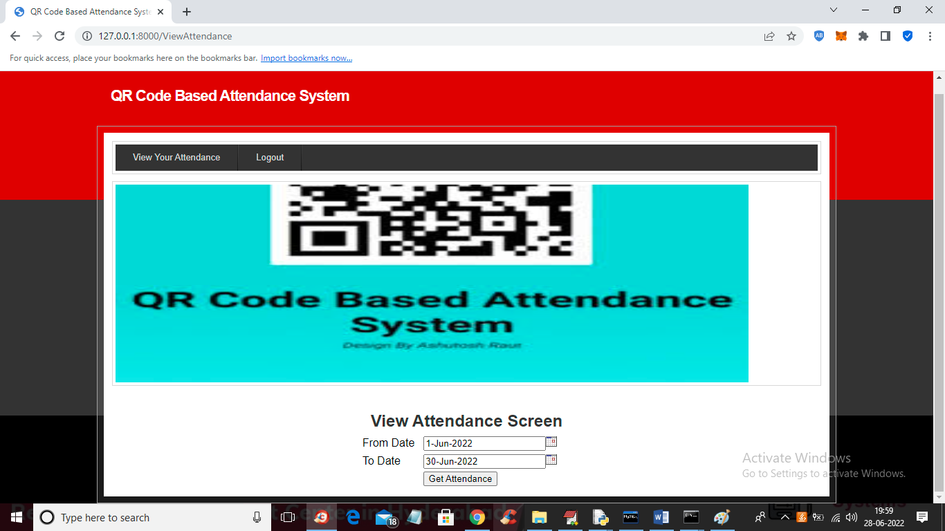
Check Attendance whether markerd or not using csv File

Slide 20
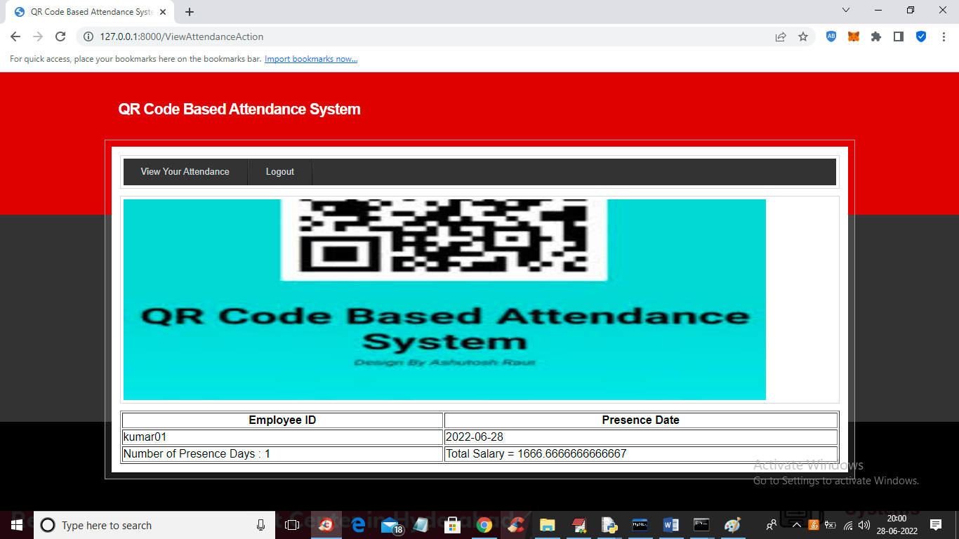
Check Using Multiple data

Slide 21
CONCLUSION
Overall, QR code-based attendance systems provide a convenient, efficient, and accurate method of recording attendance, reducing manual effort, and enhancing data management capabilities.
It is possesses a really great advantage, among the whole types of code scanning technology.
QR Code Based Smart Attendance System is the most accurate. In this project report, we have given an introduction of Attendance monitoring

Slide 22
REFERENCES
[1] M. Ahmed, S. Spagna, F. Huici, and S. Niccolini. A peek into the future:
Predicting the evolution of popularity in user generated content. In
Proceedings of the Sixth ACM International Conference on Web Search
and Data Mining, WSDM ’13, pages 607–616, New York, NY, USA,
2013. ACM.
[2] P. Bao. Modeling and predicting popularity dynamics via an influencebased
self-excited hawkes process. In Proceedings of the 25th ACM
International on Conference on Information and Knowledge Management,
CIKM ’16, pages 1897–1900, New York, NY, USA, 2016. ACM.
[3] M. Cha, H. Kwak, P. Rodriguez, Y.-Y. Ahn, and S. Moon. Analyzing
the video popularity characteristics of large-scale user generated content
systems. IEEE/ACM Trans. Netw., 17(5):1357–1370, Oct. 2009.

Slide 23
THANK YOU

